Slide 1
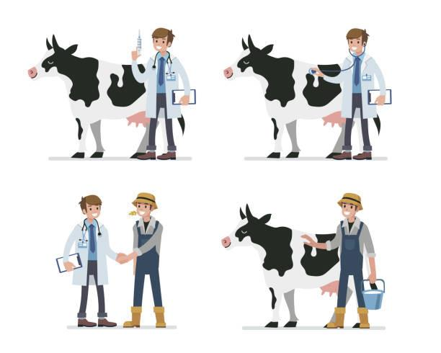
Modules(Notification sending for timely medicine taking)
HealthCare Maintained Timely
TimeLine Checking of every cow
Drug taking date is near of any one
Notify Farmers
Wait for their confirmation
Update Timeline

Slide 2
Vet service
Prescribing and Providing Medicine if Necessary
Regular Check Up via qualified Veterinarian
Health Quality of every Cattle maintained Properly
At time of any injury, instant support from vet team
Prevention of any flu expansion, resulting profit of farmers
More veterinarian will get opportunity
Vet plan initiative
Sole purpose to provide Halal products to customer
Reducing losses of farmers
Involving more quality veterinarian for service

